Slide 1
Notes:
GottaGo! campaign advocates for a network of open, safe, and accessible public toilets in the city.
Since 2013.

Slide 2
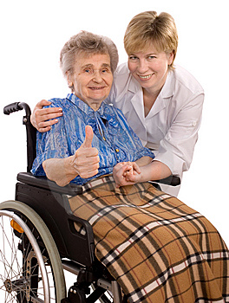
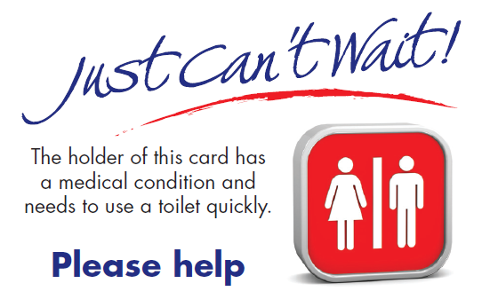
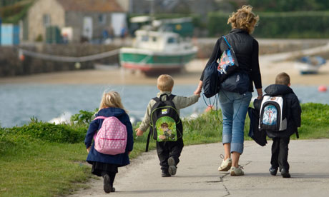
Open, accessible, public toilets are an issue for everyone
Notes:
EVERYONE is affected (100% of population)

Slide 3
Two Requests
Signage
Porta-potties in sports fields and splash pads
Notes:
We have two requests
Signage
Porta-potties in sports fields, and splash pads

Slide 4
Hidden toilets
14 public buildings
7 commercial or other buildings
1 millions residents and 10 million tourists
Notes:
There are 14 public buildings (Parliament Hill, National Gallery, NAC, City Hall, Archives, Supreme Court, Library, etc.) in downtown Ottawa with no street-level signs about where to find the toilets or when they are open.
There are another 7 commercial or other buildings in downtown identified on the Ottawa Tourist Map as having a toilet for public use but again have no street-level signs.
Ottawa has one million residents and 10 million visitors every year - how do they easily find a public toilet?

Slide 5
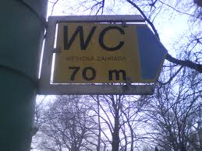
Signage: Make them easy to find
Notes:
There are 21 “hidden” PTs in downtown Ottawa, but zero signs.
Public bldgs. – NAC, National Gallery, City Hall, etc.)
Commercial bldgs. – eg: hotels
Ottawa has one million residents and 10 million visitors every year - how do they easily find a public toilet?
There are a number of downtown maps,(and APPs) including PTs. But they have conflicting information.

Slide 6
Estimated cost (signage)
Between $5.00 - $50.00 each
(plus installation and maintenance)
Notes:
From $5.00 - $50.00 per sign, depending on how fancy you want.
Average= $22 apiece.
Providing signs themselves is a relatively small cost to the city. (We recognize that installation and maintenance is a challenge & involves additional cost)

Slide 7
Porta-potties at sports fields
Provide accessible portable toilets at ten (10) facilities - where no other toilet is available – for four months (cleaned twice a week)
Cost: less than $600 for the summer per toilet
Could be on a cost recovery basis from organized sports teams that use the fields.
Notes:
Thank city for 10 (2018 and 2019).
Adding 10 more would expand coverage. (to 20 out of 650 sports fields)
This is a public health issue – players (and onlookers) drink lots of water. With no other options, what do they do? The bushes become a pitrie dish of potential diseases.

Slide 8
Porta-potties at splash pads
Provide accessible portable toilets
(through Central Allocations) at 10 splash pads
for four months during the summer
In locations with high density and low incomes
as determined by the Ottawa Neighbourhood
Survey, and as requested by communities
Cost: less than $600 per toilet for 4 months
cleaned twice weekly
Notes:
Thank city for 10 (2018 &2019).
An additional 10 expands coverage. To 20 out of 79
Total # of splash pads: 79
# of wading pools: 56
A splash pad full of small children – where there is no toilet – where do they go?
Do we need to elaborate?
It’s a clear public health hazard.

Slide 9
Minimal budget item with
maximum impact
Estimated total cost: $6,462 -$12,462
Signage: $462 (@$22 each (average)
Porta-potties in 10 splash pads - $6,000
Porta-potties in 10 sports fields - $6,000 (or $0, with
cost recovery from fees charged to teams)
Notes:
Total cost – depending on whether there is cost recovery ($6,000) for sports fields

Slide 10
Public toilet availability is not only a human dignity issue and an indicator of civilization, it is a sound economic strategy.

